Slide 1









Darija
Sentiment Analysis
using Machine learning algorithims
Presented by :
EL HADRATI Othman
Guided by :
pr. aziz khamjane
Notes:
salam l project li ghadi npresenti likom lyoum mt3ele9 b te7lil l macha3ir dyal bdarija wla bel eng Darija sentiemnt analysis using machine learning technics

Slide 2



Plan
01.
Problem Statement
Tested Models
& Evaluation
05.
02.
Data
Sourcing
06.
Project Architecture
03.
Data Cleaning
& Preprocessing
Improvements Strategies
07.
04.
Demonstration
& Conclusion
Feature Extraction
08.
Notes:
b nissba l plan ghaykoun fih 8 dyal les axes pricipale li homa :

Slide 3




What our model can Resolve ?
Notes:
9bel ndekhlo f les details dyal l project anchofo be3da fach n9edro nsste3mlo b7al had l model

Slide 4
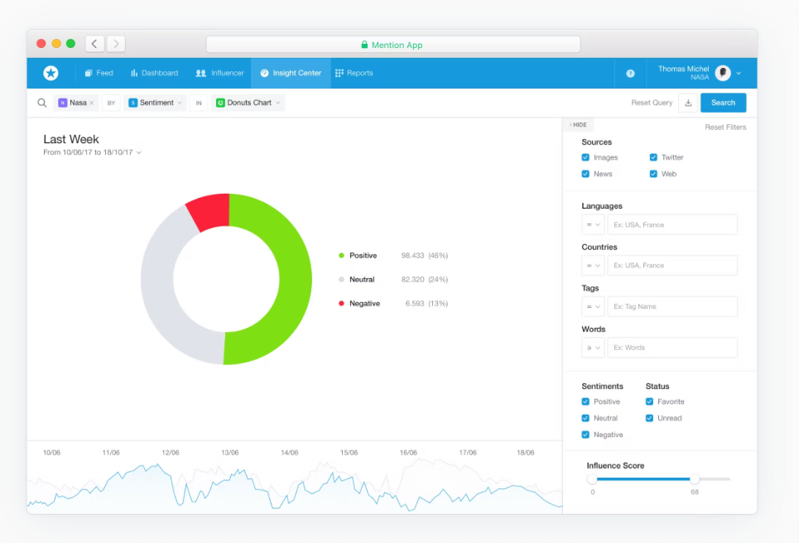
“Buffer” social media Tool
Notes:
so buufer wa7d social media tool bach kat9der t7et des posts f bezaf dyal les platforms en meme temps b7al ig o facbook o tchouf des stats dyal les post okda
fnefss lwe9t kayna la possibilitee tchouf sentiment analysis dyal les comments for exemple but limite dyalha howa anaha kat supporti le langues b7al eng wla fr
donc l7el howa chi model li kifhem darija
o hada howa exectemant l project dyali
so bach n9ado had l model khassna data li ntriniwh 3liha
donc ndouzo db nchoufo data mini jebnaha o types dyalha

Slide 5
Darija data sources ?

Slide 6

Data Sources
Labled Data
(Github sources)
Non Labled Data
(Youtube API)
Notes:
so bnissba l data li khdemt biha m9essma 3la joj labled data colectitha mn github repos :
la plupart dyalha kikoun negative o positive
o kayn li collectitha bel API dyal yt

Slide 7
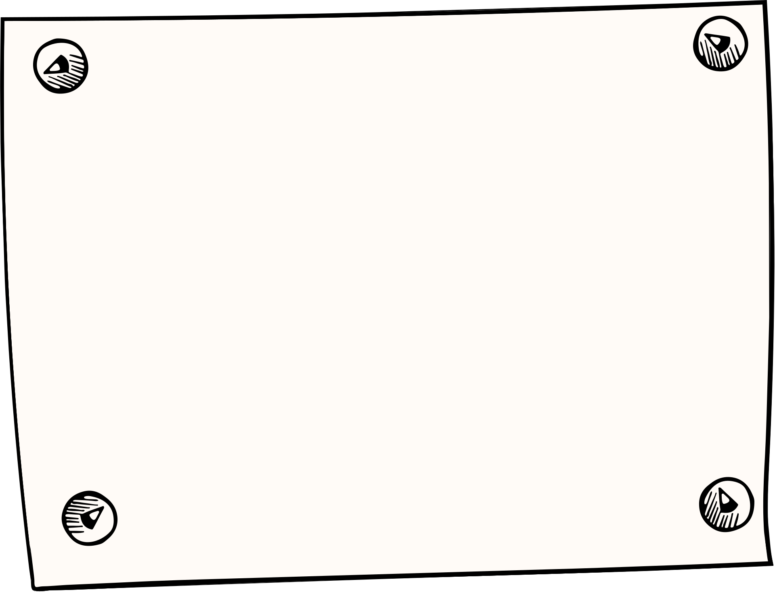
data diversity
OMCD
MAC
ELECTION 2016
LABELS: POSITIVE , NEGATIVE
LABELS: POSITIVE , NEGATIVE
AND NEUTRAL
LABELS: POSITIVE , NEGATIVE
CONTENT: Offensive social medial
comments ,hate speech ...
CONTENT: Tweets about different topics
CONTENT: Facebook comments
about the Moroccan elections
SIZE: +8,000 data rows
SIZE: +18,000 data rows
SIZE: +10,200 data rows
Notes:
so hna kifma kanchoufo 3endna 6 dyal sets li kola we7da fihom fiha wa7d l3adad dyal rows so matalan hna 3endna OMCD

Slide 8
data diversity
MDOLDD
Covid 19
OD
LABELS: POSITIVE , NEGATIVE
LABELS: POSITIVE , NEGATIVE
LABELS: Not Labeled
CONTENT: Offensive Youtube
& Twitter comments
CONTENT: comments about Covid19 pandemic
CONTENT: Youtube Comments
about different topics
SIZE: +20,400 data rows
SIZE: +4,300 data rows
SIZE: +900 data rows
Notes:
hnaya f data li smith OD jme3tha using YT API li ofcrs aghadich tkoun labled

Slide 9
How to label
data?
Notes:
so bach n labliha kan khass chwiya dyal n cleani had data

Slide 10


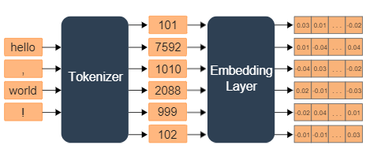

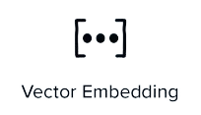

How to label data?
DarijaBert-Arabizi Pretrained Model
size : 512
Notes:
bach f had l phase lhadaf how ani n transformi data mn text l vecteurs bach iss'hall 3liya clustring dyalha o yjme3 liya bzf dyal data f nefss l cluster tq mayjme3ch liya for exemle "ssir" , "aji" fnefss l cluster , so hna khdemt wa7d fine tunned model m base 3la darija smito Darija-Bert-arabizi telque anaho m traini 3la data mektouba b latin o arabic alphabets donc i9der yssehel 3liya labling mn be3d

Slide 11
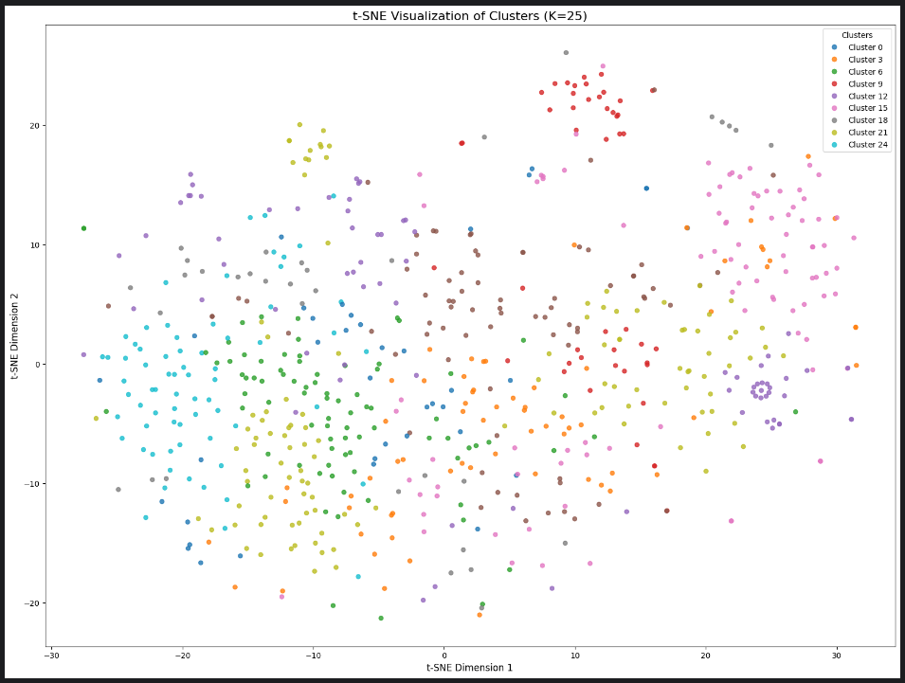
How to label data?
Data distribution after the K-means Clustring
Notes:
apres chedit had vectors o dert l kmeans bach njme3 l ljomal li 9rabin mn be3diyathom
dert 25 cluster had 25 ma3endha 7ta signification mn ghir anaho kima kan3erfo kolma kan K kbir kolma data katzid t filtra
apres lablithom manuellelment par cluster

Slide 12

How to label data?
Custer X
Custer Y
Hadchi khatiiiiiir la hawla wala kowata illa billah
شوهتونا باركة من هاذ البرامج
أستغفر الله ولا حول ولا قوة الا بالله وأتوب اليه
Chouha tv chawahtou bina
لا حول ولا قوة إلا بالله
سير ديها في راسك البنات
هما بغات
Notes:
hada exemple dyal joj dyal clusters li kherjo liya

Slide 13
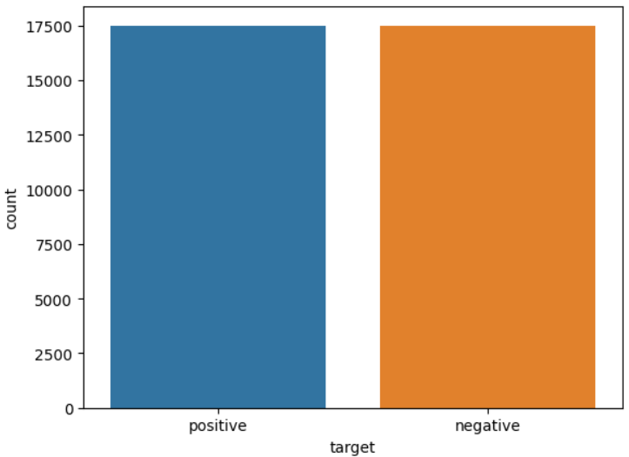
Labeled data
Notes:
flkehr khrejt b +17k dyal data data li positive o 17 li negative

Slide 14
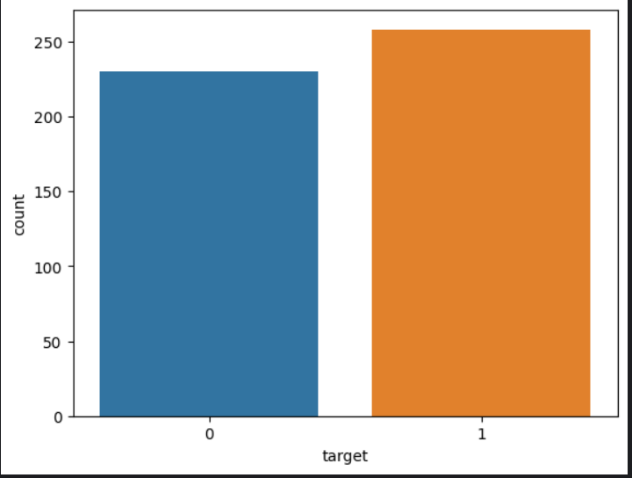
Unlabeled data
Notes:
hna l prportion dyal data li lablitha rassi

Slide 15
Data cleaning and preprocessing
Notes:
f had l ax anchoufo les differents steps bch ne9iw had data and n diro preprocessing liha

Slide 16
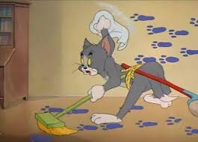
data Cleaning
DUPLICATES ROWS*
EMPTY FIELDS*
SPECIAL CHARACTERS
(#,HTML)*
Notes:
flewl chedit text colm o 7iyedt meno duplicats o empty fileds o special characters like # o timestamp dyal yt etc

Slide 17

data Cleaning
Raw text
Cleaned text
<a href=""https://www.youtube.com/watch?v=zvyapr04A1Y&amp;t=1416""/> زوينة الدخلة ديال البقالي ❤❤❤❤
'زوينة الدخلة ديال البقالي
❤❤❤❤'
شفت فيديو زوين على اليوتيوب اليوم، دخل لوقت 3:15 وكان فيه واحد الفكرة المزيانة #تعلم_برمجة!
'شفت فيديو زوين على اليوتيوب اليوم ، دخل لوقت وكان فيه واحد الفكرة المزيانة تعلم برمجة !'
Notes:
hada exemple fina les lien kit7iydo o les hashtags dyal html , o timestamps dyal yt

Slide 18
darija preprocessing
Notes:
f had la partie li mohima kifach n trater darija

Slide 19

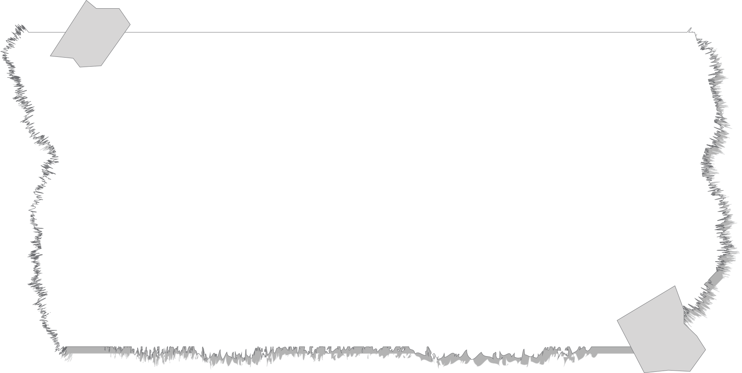


data preprocessing
Stop Words
DODa
dataset for darija stop words
Arabic /darija Stop words
from lib & files
Notes:
so flewl 7iyedt stopwords ,
had stop words jme3thom mn bzf dyal sources b7al DODa data set o other files wla library li kano soit bdarija soit b arabic

Slide 20
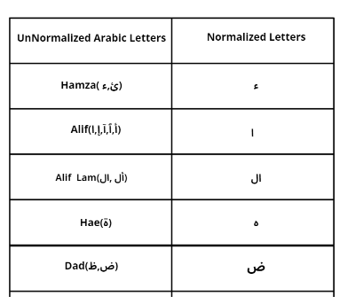
data preprocessing
Tachkeel Normalisation et ponctuation
Notes:
apres 3endna hna normalization dyal text b7al l hamza o alif etc o
lil hadaf menha howa ani n7awl njme3 bzf dyal lkelmat bach iwelif fnefss la forme
+ other technics b7al n7iyed techkil o tetweel dyal lkalimat etc

Slide 21
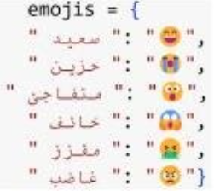
data preprocessing
Emojis Hundling
Notes:
kifma kan3erfo les imogies kile3bo dar fel meaning dyal text fa kan khass chi method bach n hundlihom li hiya n 7ewel emogi l arabic text b7al had le cas

Slide 22

data preprocessing
Stemming using Tashaphyne
شرب
شربتي
شربات
تشرب
كايشرب
يشرب
كاتشرب
كاتشربي
شرب
شرب
شرب
تشرب
كايشرب
يشرب
كاتشرب
كاتشرب
Notes:
hna lapartie dyal steaming khedemt wa7d l library li katkhdem 3la wed arabic tokens but bach n adaptiha m3a darija scrapit mn wa7d site les sufixes and prefixes dyal darija hadchi khela results ikouno chwiya 7ssen mo9aranatan m3a stemming dyal l3erbiya

Slide 23
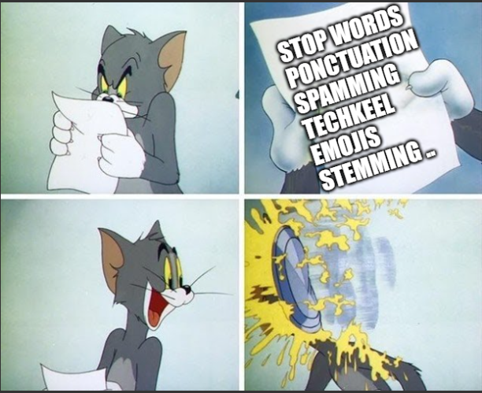
data preprocessing
Notes:
so hna kanchofo les different technics li khdemt etc
but kayn wa7d l mochkil

Slide 24
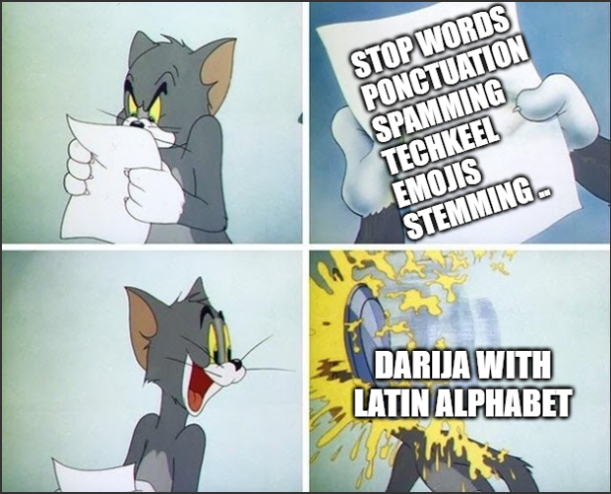
data preprocessing
Notes:
li howa ana soit text dyal user wla dyal data set nit ikoun mektoub b latin words so kan khass n hunfli had l mochkila

Slide 25

data preprocessing
Mapping (Latin to arabic)
“hadchi zwin bezaf”
“هادشي زوين بزاف”
“ma3endich m3ak
a khouya”
“ماعنديش معاك
ا خويا”
“ana dded lfikra
dyalk”
“انا ضد لفيكرا
ديالك”
Notes:
l 7el howa nssayb wa7d mapping dictionnary li fiha l7orof b latin w equivalent dyalo b 7rf 3arabi

Slide 26
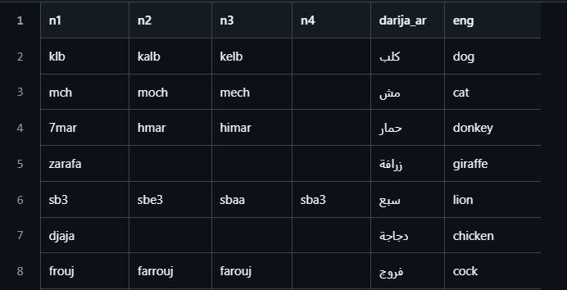
Latin Stop Words
DODa
dataset Arabizi words
Notes:
mohim hna bghi n montionner que khdemt auddi des stop words li mektoubin b latin words bach nzid n filtrer text

Slide 27
Feature extraction
Notes:
f had l partie ki khess n7ewl text l tokens o nrepresentiha b vectors

Slide 28
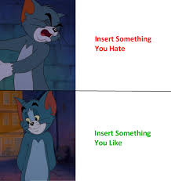
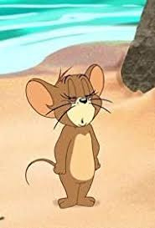
Feature extraction
BOW
Binary BOW
TF-IDF
Notes:
so hna kifma kan3erfo ana TF-IDF ki3ti results 7ssen mn BOW wla binary BOw
walakin jerebthom kamlin bach ndiro comparaison f lekher

Slide 29



Feature extraction
TF
IDF
Term
Frequency
Inverse Document Frequency
Notes:
mohim hna TF-IDF kifma kan3rfo kat3ni time frequency li hiya ch7al mn mera l kelma bant f wa7dt text m3a 3adad l kalimat dyal dak text
o IDF howa ch7al dyal text 3endi 3la l3adad

Slide 30


Feature extraction
Task | Result
Original Text | أحسن الحكومة في المغرب، سأصوت على العدالة والتنمية. إنهم أناس شرفاء لم يسرقوا بلدنا. النصر حليفهم إن شاء الله
Text Cleaning | ['سأصوت', 'لم', 'يسرقوا', 'شرفاء', 'والتنمية', 'العدالة', 'النصر', 'حليفهم', 'أحسن', 'أناس']
Unigrams | 'أحسن','أناس','العدالة','النصر','حليفهم','سأصوت','شرفاء','لم', 'والتنمية', 'يسرقوا'
Bigrams | ['أحسن', 'أحسن أناس', 'أناس', 'العدالة', 'العدالة نصر','النصر',النصر حليفهم', 'حليفهم', 'حليفهم أحسن','سأصوت', 'سأصوت لم', 'شرفاء', 'شرفاء والتنمية', 'لم', 'لم يسرقوا', 'والتنمية','والتنمية العدالة', 'يسرقوا', 'يسرقوا شرفاء']
Trigrams | ['أحسن', 'أحسن أناس', 'أناس', 'العدالة', 'العدالة النصر','العدالة النصر حليفهم', 'النصر', 'النصر حليفهم','النصر حليفهم أحسن', 'حليفهم', 'حليفهم أحسن', 'حليفهم أحسن أناس', 'سأصوت', 'سأصوت لم', 'سأصوت لم يسرقوا', 'شرفاء', 'شرفاء والتنمية','شرفاء والتنمية العدالة', 'لم', 'لم يسرقوا', 'لم يسرقوا شرفاء','والتنمية', 'والتنمية العدالة', 'والتنمية العدالة النصر', 'يسرقوا','يسرقوا شرفاء', 'يسرقوا شرفاء والتنمية']
+200k
vocabulary
size

Slide 31
Tested Models
ML
Logistic regression
Decision tree
Naive bayes
Random forest
XGboost
SVM

Slide 32

Tested Models
DL
RNN
CNN
Bert
Darija-bert
darija-bert-arabizi
Morrbert

Slide 33
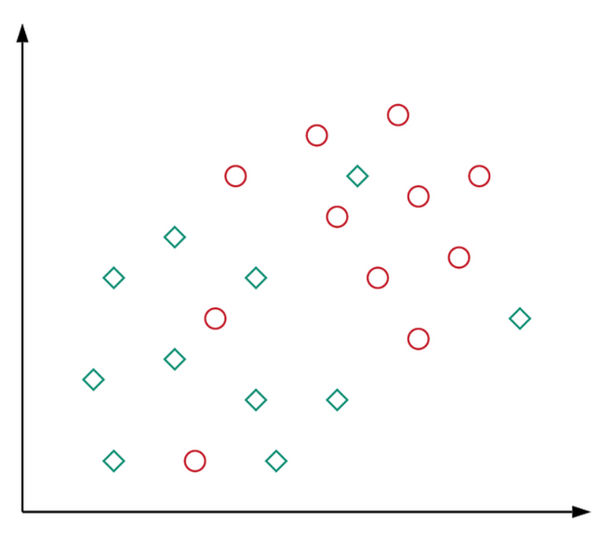
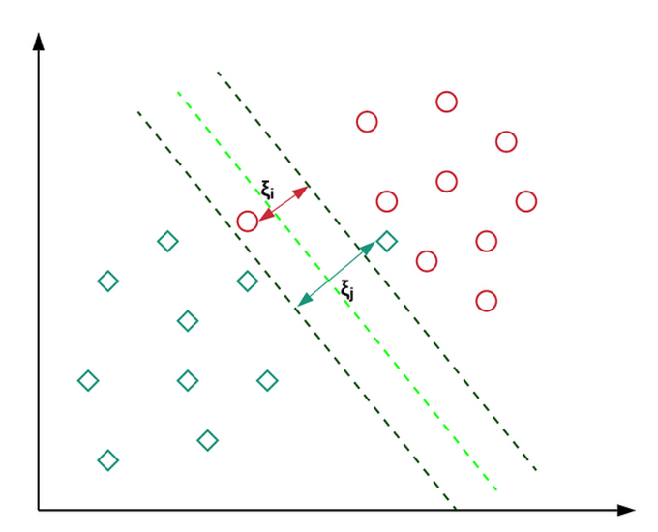

SUpport vector machine
(SVM)
Notes:
so l model li 3tani a7ssen result howa svm
en general svm dawr dyalo howa ifre9 les deux class (pos o neg fhad l7ala) bwa7d l hyperplan
o bach n assuriw ana l model ikoun flexible khdemt b soft margin svm li kikheli wa7d la marg d'erreur bach maykounch overfitting
lhadaf mn hadchi how nl9aw akbar margin o ykoun l model flexible ye3ni kikheli some missclassifed points ikono 3endna
ila kant C sghira farah kankheliw lmodel idir chi missclassifyin o hadchi ki3tina wa7d l margin li kbir
ila keberna C farah dik sa3a kanrezo 3la ana lmodel maydirch bzf dyal missclassifying o dik sa3a margin kikoun sghir

Slide 34
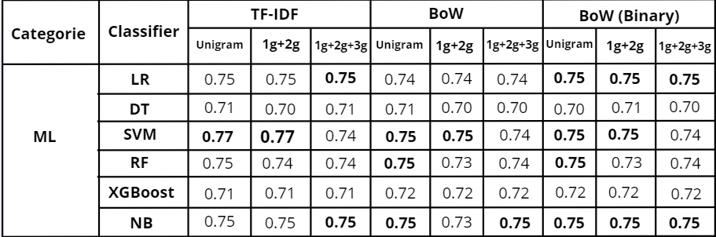

Evaluation tested tuned models

Slide 35
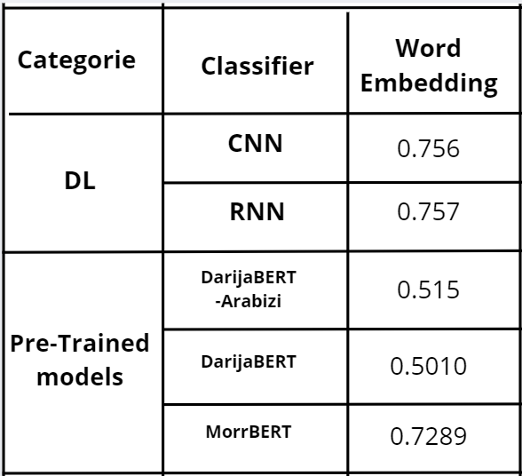
Evaluation tested tuned models

Slide 36
Benchmark
Model\metric | precision | recall | f1-score | accuracy
best model (SVM) | 0.77 | 0.77 | 0.77 | 0.77
hamza’s model | 0.74 | 0.74 | 0.74 | 0.74

Slide 37

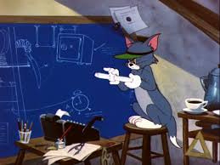
project architecture

Slide 38








project architecture
Video Comments
BackEnd
Web UI
Users
Amazon S3
DynamoDB
ML Model
User Text

Slide 39





Improvements Strategies :
Active LEarning
User Feedback
Automate
re-training the model

Slide 40

Demonstration
Web App Link

Slide 41

any Questions?

Slide 42

thank you!

